Slide 1

4 Steps to Action Mapping
Adapted from Cathy-Moore.com

Slide 2

No More Information Dumps
What is the goal for this eLearning module? Identify the goal by defining the behavioural change you want to create. Your goal needs to be measurable!
Action Mapping Step 1

Slide 3
eLearning Mistake #1
i.e. The goal of this eLearning module is that hand hygiene compliance audit results will increase.
Action Mapping Step 1

Slide 4



Identify what the learners need to do by listing the actions the learners must take to meet the goal.
These are your learning outcomes based on Bloom’s Taxonomy Action Verbs.
Action Mapping Step 2

Slide 5
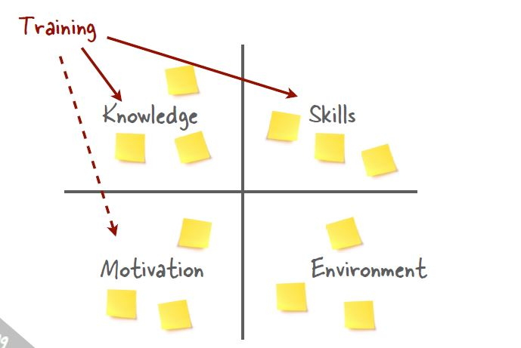
Identify why people aren’t currently taking the necessary actions and consider the areas in which training can actually solve the workplace problem.
Action Mapping Step 2

Slide 6

Design practice activities that mirror the real-world as much as possible. At least one activity for each learning outcome.
Avoid fact checks and trivia questions as these do not mirror the real world.
Action Mapping Step 3

Slide 7


Identify what people really need to know by curating the information that learners must have to complete the practice activities.
“need to know information”
“nice to know information”
Action Mapping Step 4

Slide 8






Content slides need to be information that learners must have to complete the practice activities.
Action Mapping Step 4
8

Slide 9
In the end our eLearning module is:
A stream of realistic compelling challenges/activities
Supported by tightly focused material like job aids or other NECESSARY information
Has measurable impact on the learner’s performance
Stream of realistic challenges /activities
activity
activity
activity
activity
Job Aid or other NECESSARY info
info
info
info
Action Map Summary

Slide 10



Congratulations!
Draw Your Final Action Map Here
You’re Ready to Take Action!

Slide 11
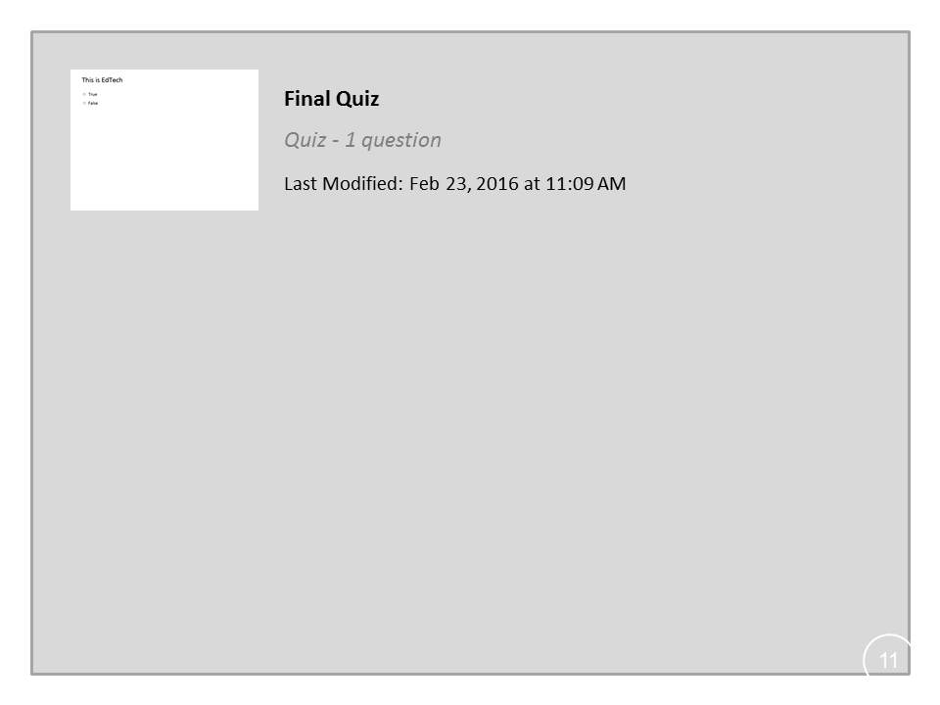
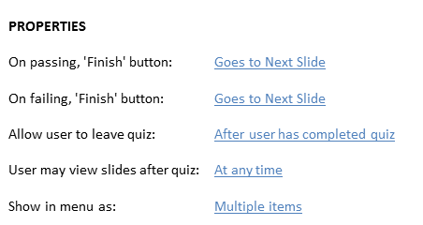


Final Quiz

